Slide 1
CUSTOMER’S BEHAVIOUR ANALYSIS REPORT
Customer Behaviour Analysis for an E-commerce Business: Understanding Customer Value, Engagement, and Retention Drivers
Prepared by – Tolulope Oni
Tool Used - Power BI | Power Query(Data Cleaning)

Slide 2
OBJECTIVES
This reports covers:
Product performance
Segmentation
Drop-off point
Engagement and revenue.

Slide 3
DATASET OVERVIEW
This dataset contains 5000 e-commerce transactions from a Turkish online retail platform, spanning from January 2023 to march 2024
The dataset has 18 columns and 17049 rows which provides detailed insights into customer demographics, purchasing behaviour, product preferences and engagement metrics.

Slide 4
KEY INSIGHTS
A. Revenue contribution by customer
The analysis shows that the top 500 customers contribute approximately 38.8% of total revenue, indicating a concentrated revenue structure driven by a relatively small group of high-value, repeat customers. This highlights both a retention opportunity and a revenue risk if these customers are not effectively managed
B. Repeat vs One-Time Customer Behavior
The higher number of returning-customer (Approximately 60%) transactions compared to one-time purchases indicates that many customers place multiple orders. While the dataset contains 5,000 unique customers, repeat customers generate several transactions each, highlighting strong engagement and a revenue model driven largely by returning customers

Slide 5
KEY INSIGHTS
C. Customer Segmentation
Customer revenue contribution is heavily concentrated among young adults, with gender playing a secondary role.
Young adults alone contribute 68.3% of total revenue, making them the dominant customer group.
D. Engagement and revenue.
Customer engagement levels are consistent across product categories, but revenue varies significantly
Electronics and Home & Garden convert engagement most effectively, while Books, Food, and Toys present monetization opportunities through bundling and upselling

Slide 6
KEY INSIGHTS
E. Product Category Performance
Revenue is heavily concentrated in Electronics, which significantly outperforms all other product categories, while Home & Garden and Sports serve as strong secondary contributors and lower-value categories present monetization opportunities rather than primary revenue drivers.

Slide 7
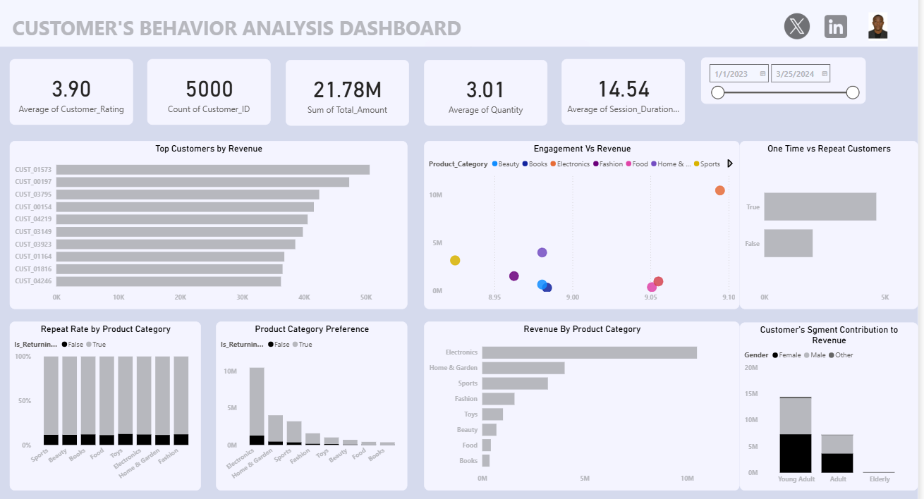
VISUALISATION

Slide 8
RECOMMENDATIONS
Prioritize the top 500 customers as a strategic revenue asset and monitor satisfaction, delivery time, and engagement closely for this group.
A sizable number of one-time buyers still exist which gives the opportunity to convert first-time buyers into repeat customers.
Double down on young adults through personalized campaigns, loyalty programs and trend driven product promotions
Engagement is not problem, conversion and pricing are. Low revenue categories are not uninteresting, they suffer from low unit value, not lack of engagement. Electronics and Home & Garden convert engagement most effectively, while Books, Food, and Toys present monetization opportunities through bundling and upselling
Protect and scale Electronics - Ensure availability, competitive pricing, and fast delivery, Prioritize Electronics in marketing campaigns.

Slide 9
CONCLUSION
The customer behaviour analysis reveals that business performance is driven primarily by a relatively small group of highly engaged, repeat customers and a few high-performing product categories.
Revenue is highly concentrated, with the top 500 customers contributing approximately 38.8% of total spend, indicating strong customer loyalty but also a dependency risk if these customers are not effectively retained. Returning customers generate significantly more transactions than one-time buyers, confirming that repeat behavior is a key driver of revenue growth.
Customer segmentation shows that young adults—across both genders—are the dominant revenue contributors, accounting for the majority of total spend. This suggests that age is a stronger determinant of customer value than gender, and that the business’s offerings are well-aligned with the preferences of this demographic.
From a product perspective, Electronics clearly outperforms all other categories, acting as the primary revenue engine, while Home & Garden and Sports serve as strong secondary contributors. Other categories demonstrate similar engagement levels but lower revenue, indicating that monetization challenges are driven more by pricing and basket size than by lack of customer interest.

